Slide 1

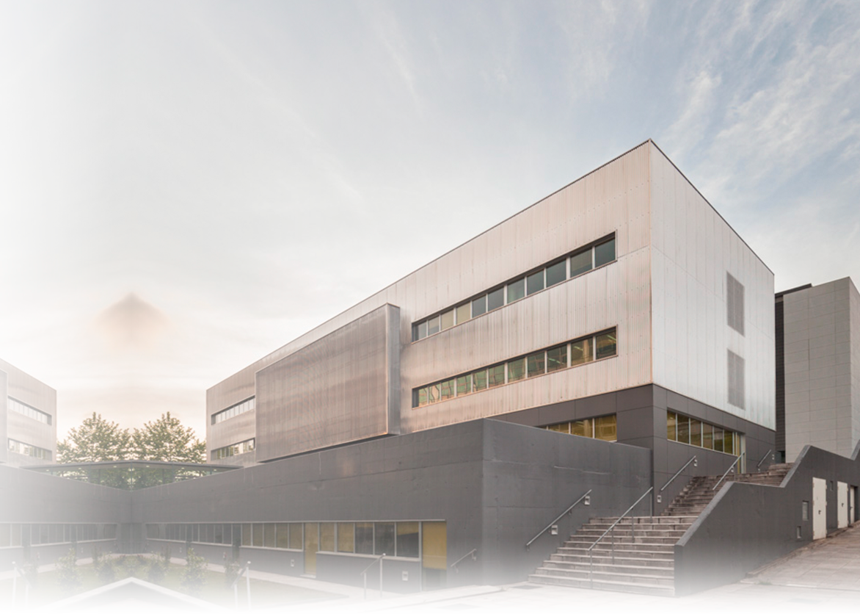


Intelligent Technologies at every step

Slide 2















Singular Research Centers Network
Centro Singular de Investigación en Química Biolóxica e Materiais Moleculares
Centro Singular de Investigación en Medicina Molecular e Enfermidades Crónicas

Slide 3
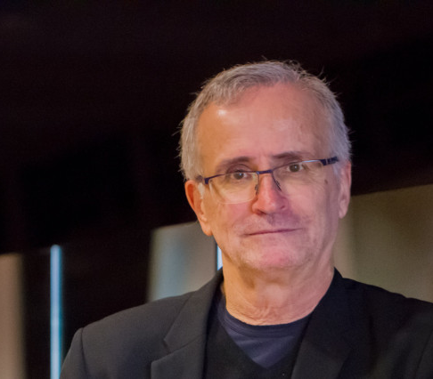


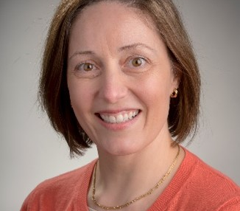


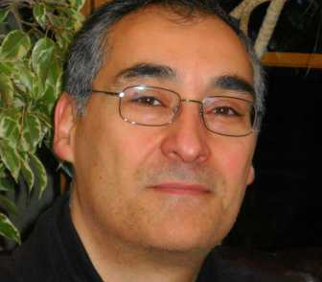
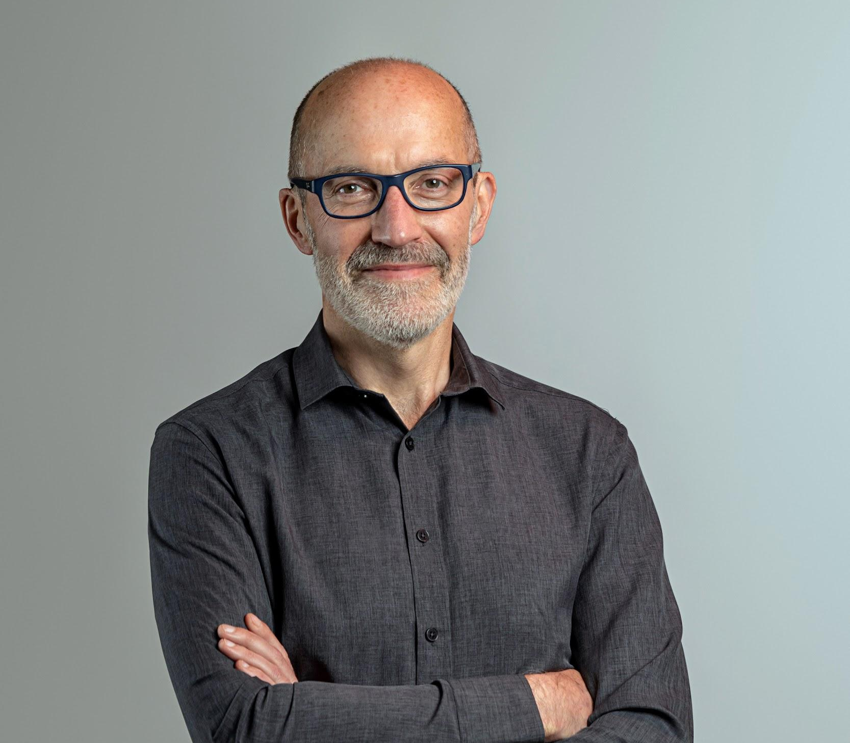
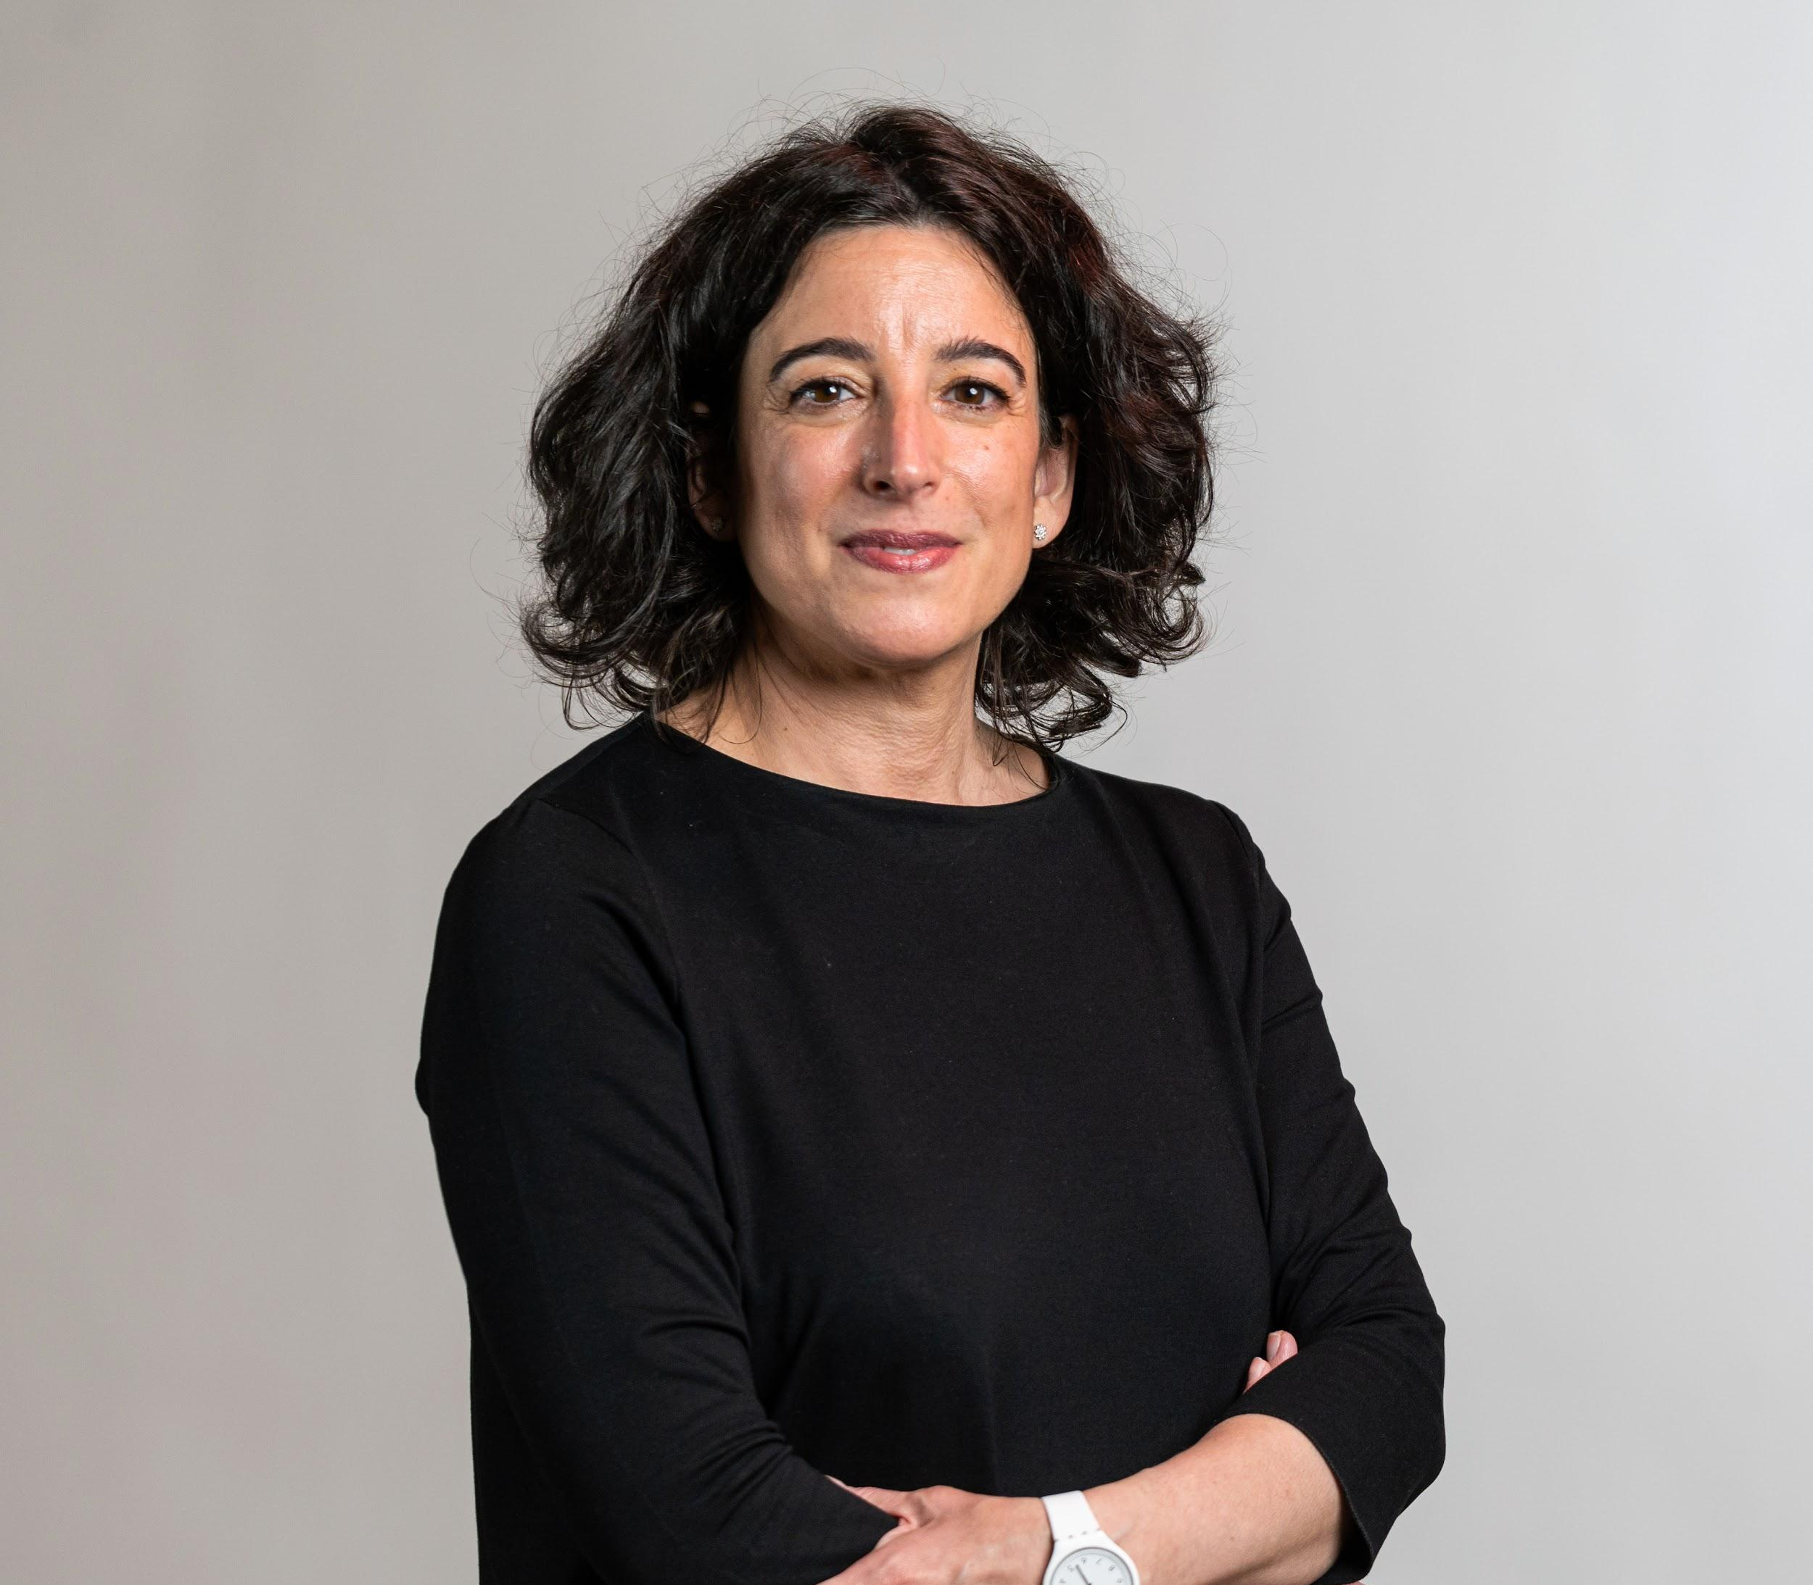


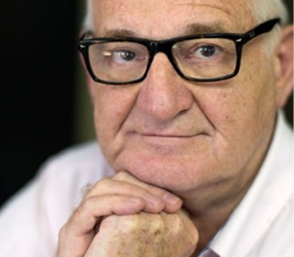


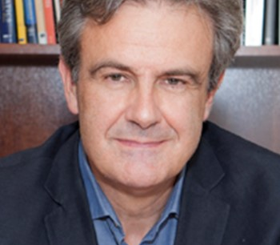


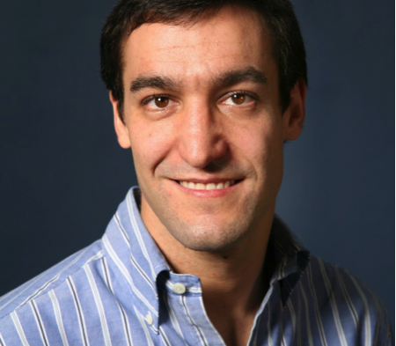


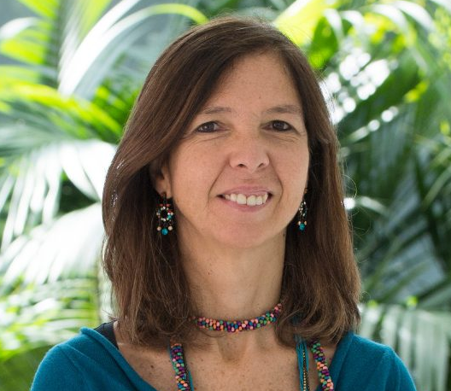


Governance
GOVERNING COMMITTEE
SCIENTIFIC ADVISORY BOARD
BUSINESS AND SOCIAL COUNCIL
RAMÓN LÓPEZ DE MÁNTARAS
INSTITUT D’INVESTIGACIÓ EN INTELIGÉNCIA ARTIFICIAL DEL CENTRO SUPERIOR DE INVESTIGACIONES CIENTÍFICAS - IIIA-CSIC
MAITE TABOADA
SIMON FRASER UNIVERSITY – SFU
Canadá
GUSTAVO ALONSO
EIDGENÖSSISCHE TECHNISCHE HOCHSCHULE ZÜRICH – ETHZ
Suiza
FRANCISCO TIRADO
CENTRO DE SUPERCOMPUTACIÓN COMPLUTENSE DE LA UNIVERSIDAD COMPLUTENSE DE MADRID - UCM
SCIENTIFIC DIRECTOR
Support Committee
DEPUTY DIRECTOR
PEDRO LARRAÑAGA
UNIVERSIDAD POLITÉCNICA DE MADRID - UPM
DAVID ATIENZA
ÉCOLE POLYTECHNIQUE FÉDÉRALE DE LAUSANNE - EPFL
Suiza
ANA PAIVA
INSTITUTO SUPERIOR TÉCNICO, UNIVERSIDADE DE LISBOA - IST
Portugal
STRATEGIC AREA
TECHNICAL AREA
COMMUNICATION AREA
PLANNING AREA

Slide 4

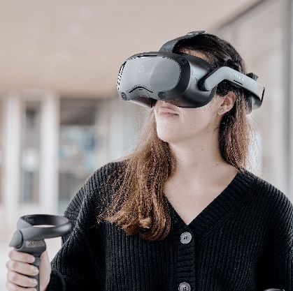
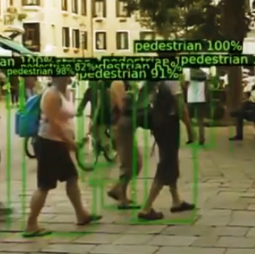
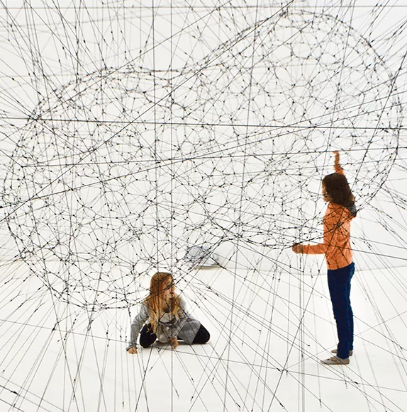

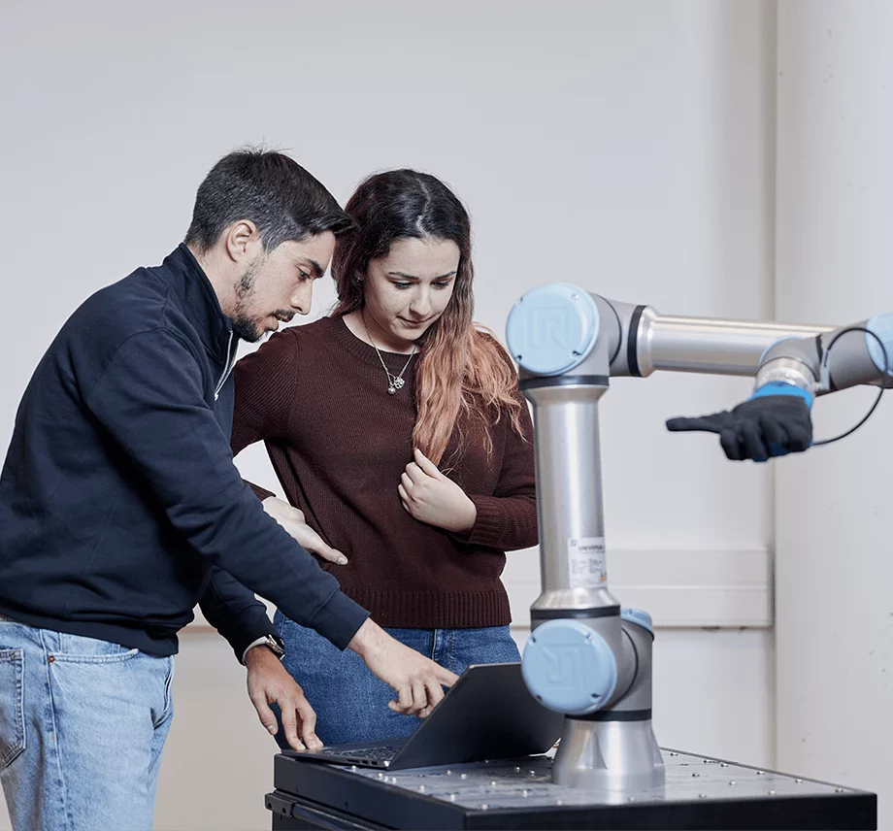
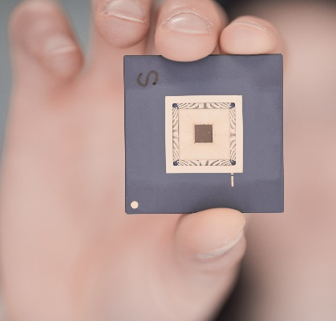



Scientific Areas
High performance computing
Natural and artificially intelligent word
Virtual and augmented reality
Computer Vision
Automatic learning and reasoning
Intelligent systems and environments
Trustworthy AI
Robotics
Electronic design of intelligent devices
Data and process science and engineering
Language technologies
Devices and computing resources
Support to machine intelligence
Social, economic, ethical and political framework
Intelligent Technologies

Slide 5

Team
ERC – CoG
1
13
Ramón y Cajal
2
31
Unidades de Gestión
36%
international
Distinguished researchers
1
Senior researchers
144 people
73
30%
HR Fellowships
Investigadores Predoctorales
10
Ramón y Cajal
1
Postdoctoral
researchers
8
7
ESRs from MSCA-ETNs
1
10
Research technicians
Beatriz Galindo
1
Collaborators
María Zambrano

Slide 6


Results
2019-21
Scientific activity
Funding
16%
European projects
72%
9,22 M€
24%
HR
36%
40%
75% no basal
22% of publications in the top 10% of most cited
28%
Technology transfer
Q1
Articles
D1
Articles
International
co-authors
Transferencia
2014
8 Software licenses
33 Projects
2 Spin-offs
2020

Slide 7









Most important projects
NL4XAI
MENELAOS ^{NT}
MISEL
MiniSTOR
Interactive Natural Language Technology for Explainable Artificial Intelligence
COORDINATION
H2020 – MSCA - ETN 2019-23
2,8M€ (666,3k€)
Multimodal Environmental Exploration Systems – Novel Technologies
SCIENTIFIC COORDINATION
H2020 – MSCA - ETN 2020-23
3,6M€ (419,7k€)
Multispectral Intelligent Vision System with Embedded Low-power Neural Computing
WP LEADER
H2020 – FET PROACTIVE 2021-24
4,9M€ (653,3k€)
Minimal Size Thermal and Electrical Energy Storage System for In-Situ Residential Installation
H2020-Energy Efficient Buildings 2019-24
8,5M€ (219,9k€)
HYBRIDS
NANOVR
DATALife
iRead4Skills
Hybrid intelligence to monitor, promote and analyse transformations in good democracy practices
COORDINATION
HORIZON-MSCA-DN 2023-26
2,89M€ (500,4k€)
Nanoscale design using Virtual Reality
H2020-ERC-CoG
2022-27
1,98M€
DIH for the deployment of AI and Data Analytics in SMEs in the primary, biotechnological and health sectors
DIGITAL DIH 2022-25
5,8M€ (465,5k€)
Intelligent Reading Improvement System for Fundamental and Transversall Skills Development
HORIZON – TRANSFORMATIONS 2023-25
2,7M€ (299,5k€)

Slide 8



Next-Gen Projects
NÓS
QUANTUM
MARINE SCIENCES
Artificial Intelligence at the service of
Galician language
COORDINATION
XUNTA DE GALICIA & NEXT-GEN
2021-2025
15,5M€ (500,4k€)
Galicia Quantum communication Programme
COORDINATION USC
XUNTA DE GALICIA & NEXT-GEN
2022-2024
9,2M€ (310,6k€)
Galicia Marine Sciences Programme
XUNTA DE GALICIA & NEXT-GEN
2022-2024
10M€ (200,0k€)

