Slide 1
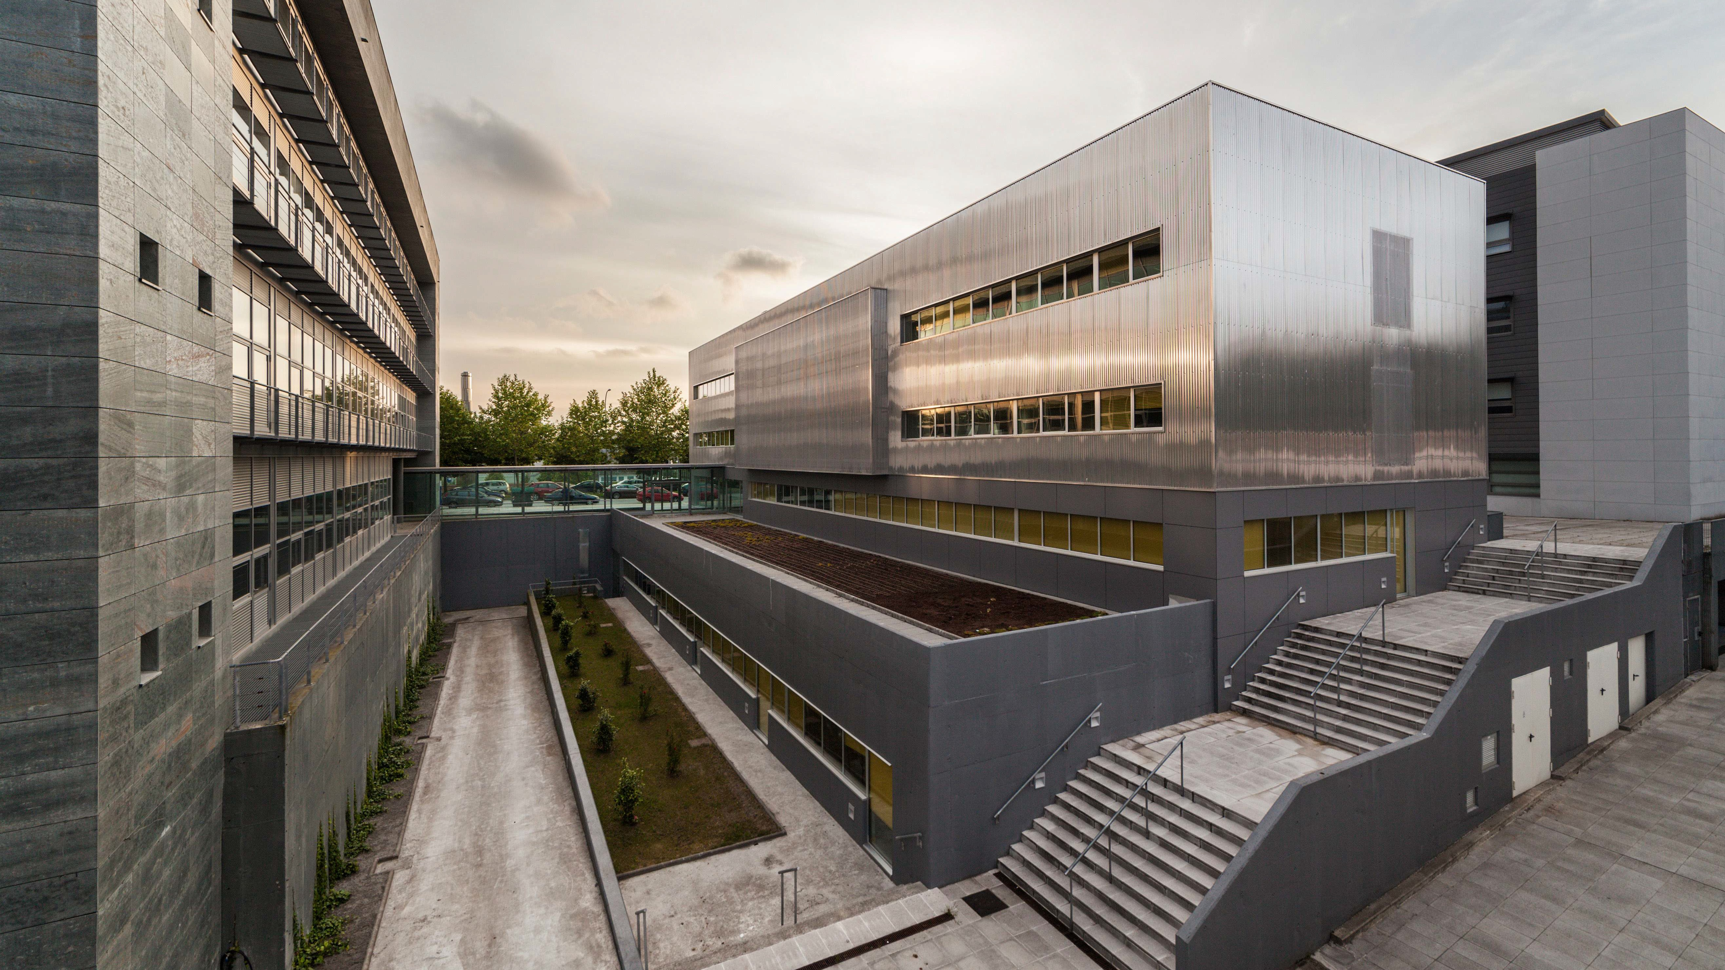
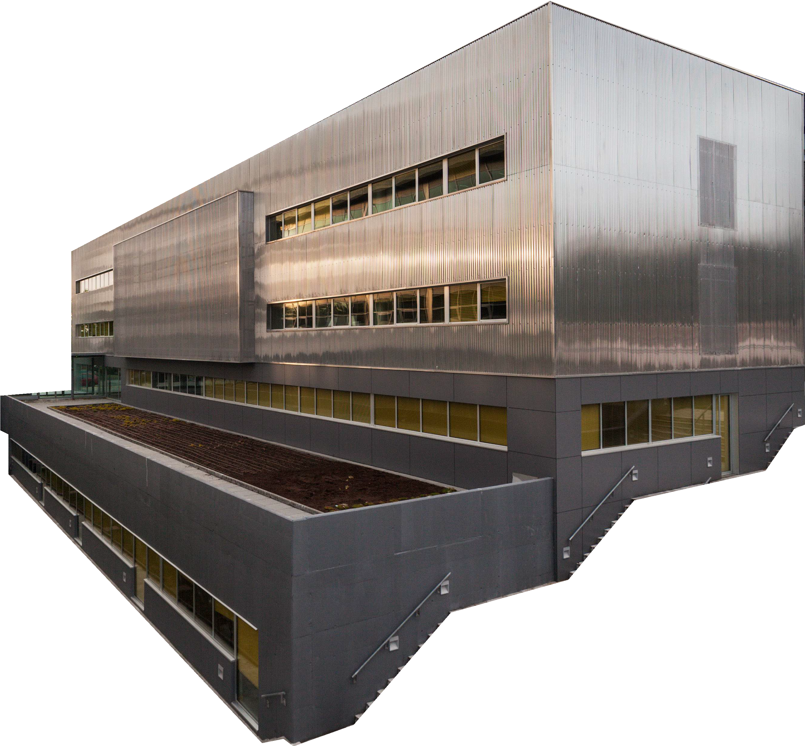
INTELLIGENT TECHNOLOGIES AT EVERY STEP
FEDER
Fondo Europeo de Desenvolvemento Rexional "Unha maneira de facer Europa"

Slide 2
NETWORK OF
SINGULAR RESEARCH CENTERS
Centro Singular de Investigación en Tecnoloxías Intelixentes
Centro Singular de Investigación en Química Biolóxica e Materiais Moleculares
Centro Singular de Investigación en Medicina Molecular e Enfermidades Crónicas

Slide 3
12
TEAM
31
R&D TECHNICIANS
SENIOR RESEARCHERS
29%
66
TEAM
+110 people
INTERNATIONAL
RESEARCHERS
13
8
PhD RESEARCHERS
NATIONALITIES
1
Beatriz Galindo
POSTDOCTORAL RESEARCHERS
12
SUPPORT TECHNICIANS
3
Ramón y Cajal
1
Juan de la Cierva

Slide 4
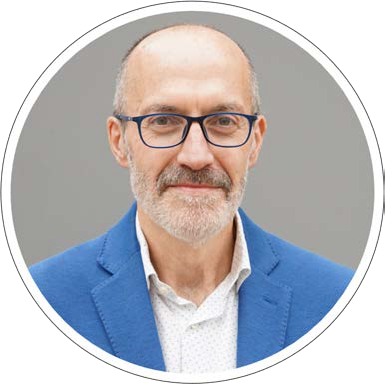
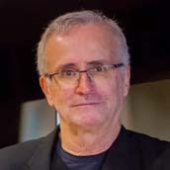
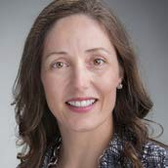
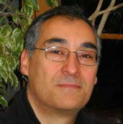
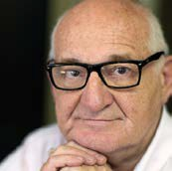
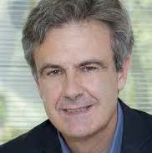
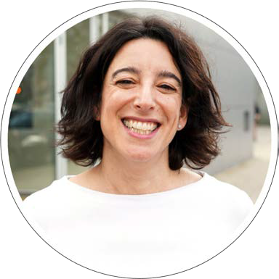
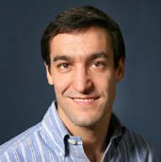
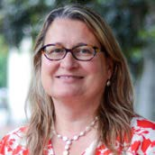
ORGANISATION
GOVERNING COMMITTEE
SCIENTIFIC ADVISORY BOARD
BUSINESS COUNCIL
PROF. DR. RAMÓN LÓPEZ DE MÁNTARAS
INSTITUT D’INVESTIGACIÓ EN INTELIGÉNCIA ARTIFICIAL DEL CENTRO SUPERIOR DE INVESTIGACIONES CIENTÍFICAS - IIA – CSIC
PROF. DRA. MAITE TABOADA
SIMON FRASER UNIVERSITY - SFU
SCIENTIFIC DIRECTOR
PROF. DR. GUSTAVO ALONSO
EIDGENÖSSISCHE TECHNISCHE HOCHSCHULE ZÜRICH - ETHZ
ADVISORY COMMITTEE
PROF. DR. FRANCISCO TIRADO
UNIVERSIDAD COMPLUTENSE DE MADRID - UCM
PROF. DR. PEDRO LARRAÑAGA
UNIVERSIDAD POLITÉCNICA DE MADRID - UPM
PROF. DR. DAVID ATIENZA
ÉCOLE POLYTECHNIQUE FÉDÉRALE DE LAUSANNE - EPFL
PROF. DRA. YOLANDA GIL
UNIVERSITY OF SOUTH CALIFORNIA - USC
DEPUTY DIRECTOR
SUPPORTING AREAS
STRATEGIC AREA
TECHNICAL AREA
COMMUNICATION AREA
ADMINISTRATIVE AREA

Slide 5
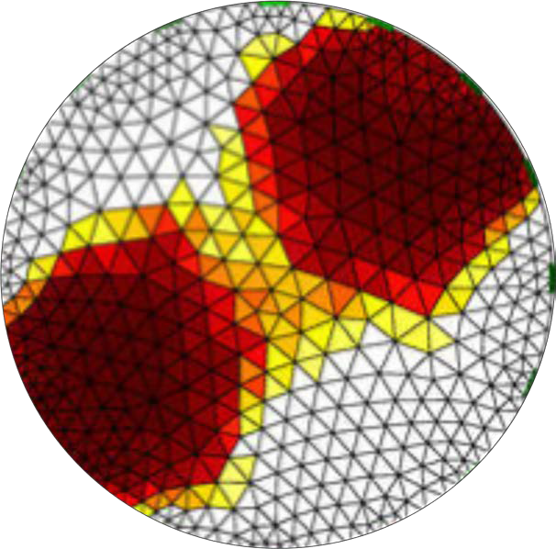
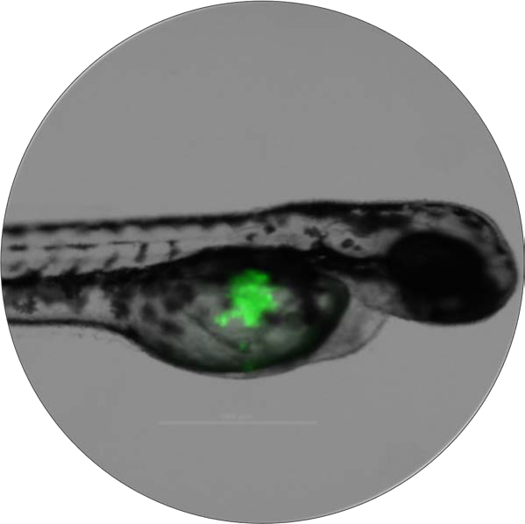
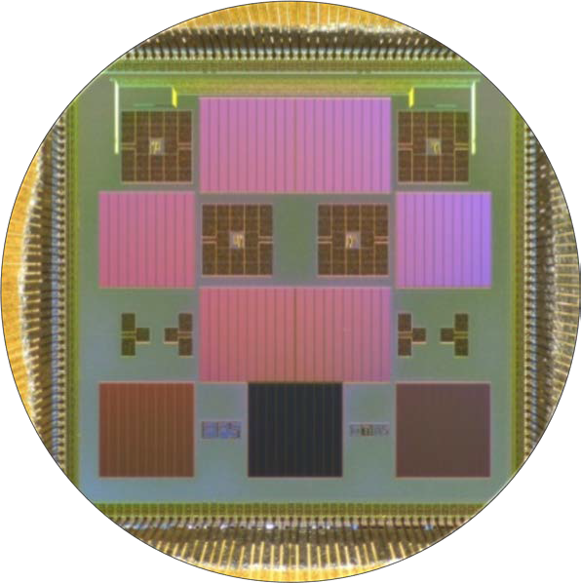
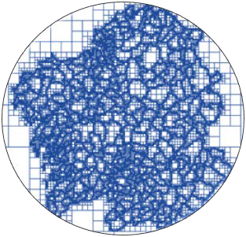
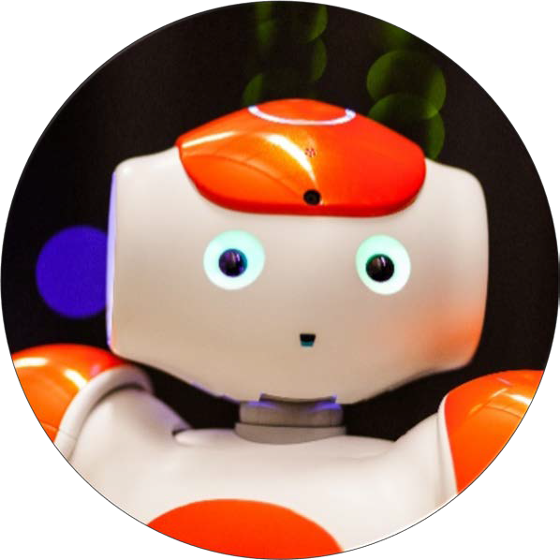
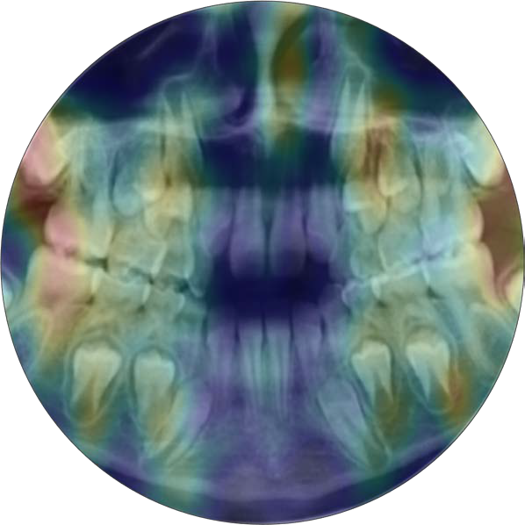
SCIENTIFIC PROGRAMMES
Machine learning
Artificial vision
Autonomous sensors
Approximate processing
Personal robots
Natural language technologies
e-Health
Advanced computing

Slide 6
SCIENTIFIC AND TECHNOLOGY TRANSFER ACTIVITY
Q2-Q4
Q1
D1
2018
17
27
10
ATTRACTED FUNDING
9,8 M€
2019
11
38
26
2018-20
SCIENTIFIC PRODUCTION
2020
6
29
22
28%
28%
PERIOD
128 Articles
73%
45%
27 PhD
20%
TECHNOLOGY TRANSFER
28% of the
NON STRUCTURAL FUNDING
comes from the industry
LICENCIAS DE
SOFTWARE
25K€
con ingresos
ROYALTIES INCOME
por regalías
FROM TOTAL :
EUROPEAN PROJECTS
HR
R&D WITH INDUSTRY
60% of technology transfer incomes are through
DIRECT CONTRACTS

Slide 7
MAIN INTERNATIONAL PROJECTS
NLX4XAI: Interactive Natural Language Technology for Explainable Artificial Intelligence. COORDINATION, Univ. Aberdeen (UK), IIIA - CSIC (ES), Univ. Delft (NL), CNRS (FR), Univ. Malta (MT), Univ. Utrecht (NL), IFISPAN (PL), Univ. Twente (NL), Indra (ES)
MENELAOS_NT: Multimodal Environmental Exploration Systems – Novel Technologies. SCIENTIFIC COORDINATION, Univ. Siegen (DE), Univ. Sabanci (TR), Ingeniería Insitu (ES), Fraunhofer (DE), Univ. Bucharest (RO), Weizmann Institute (IL)
MISEL: Multispectral Intelligent Vision System with Embedded Low-power Neural Computing. VTT Technical Research Centre of Finland (leader), Amo, Bergische Universitaet Wuppertal, Fraunhofer Gesellschaft Zur Foerderung Der Angewandten Forschung E.V., Kovilta Oy, Laboratoire National de Metrologie Et D’Essais, Lunds Universitet, Politechnika Lodzka
2020 FETPROACT-09-2020
TRAFAIR: Understanding Traffic Flows to Improve Air quality. Università Degli Studi di Módena e Reggio Emilia (líder), CESGA, Comune di Modena (CMO), Concello de Santiago de Compostela, LepidaSpA, Regione Toscana (TR), Universidad de Zaragoza, Dipartimento di Ingegneria dell'Informazione, Università degli Studi di Firenze(UNIFI)
Public Open Data, CEF Telecom

Slide 8
INTERNATIONAL COLLABORATIONS
NETHERLANDS
GERMANY
FRANCE
SWITZERLAND
ISRAEL
UNITED KINGDOM
CZECH REPUBLIC
CHINA
PORTUGAL
POLAND
KOREA
CHILE
BRAZIL
ISLAND
ITALY
AUSTRALIA
USA

Slide 9
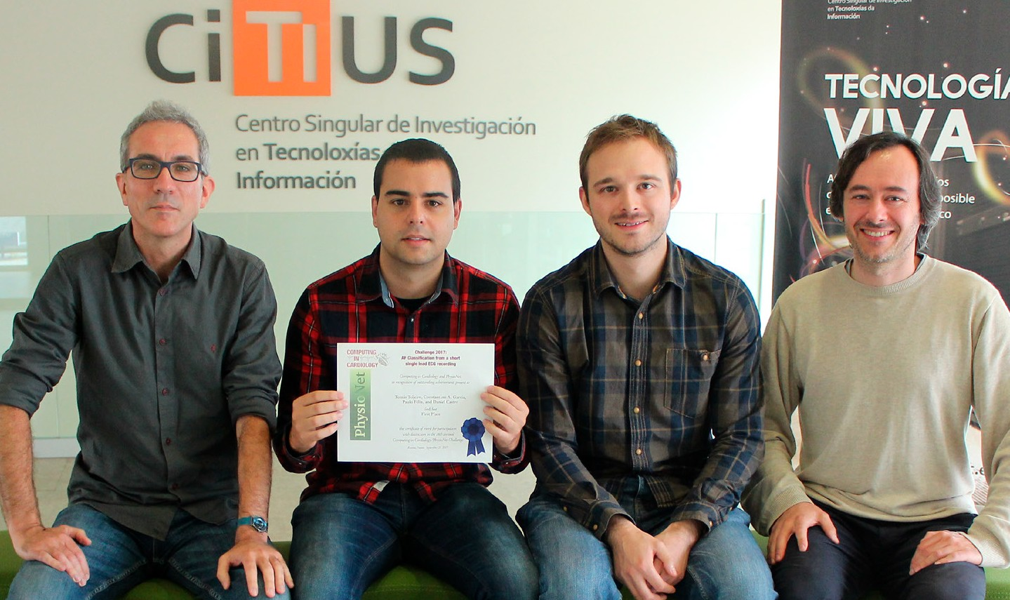
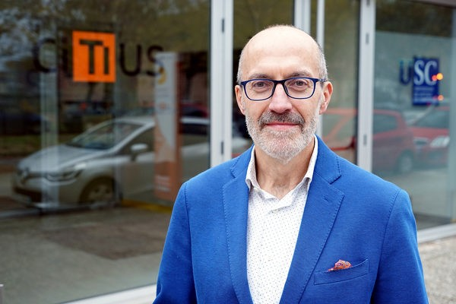
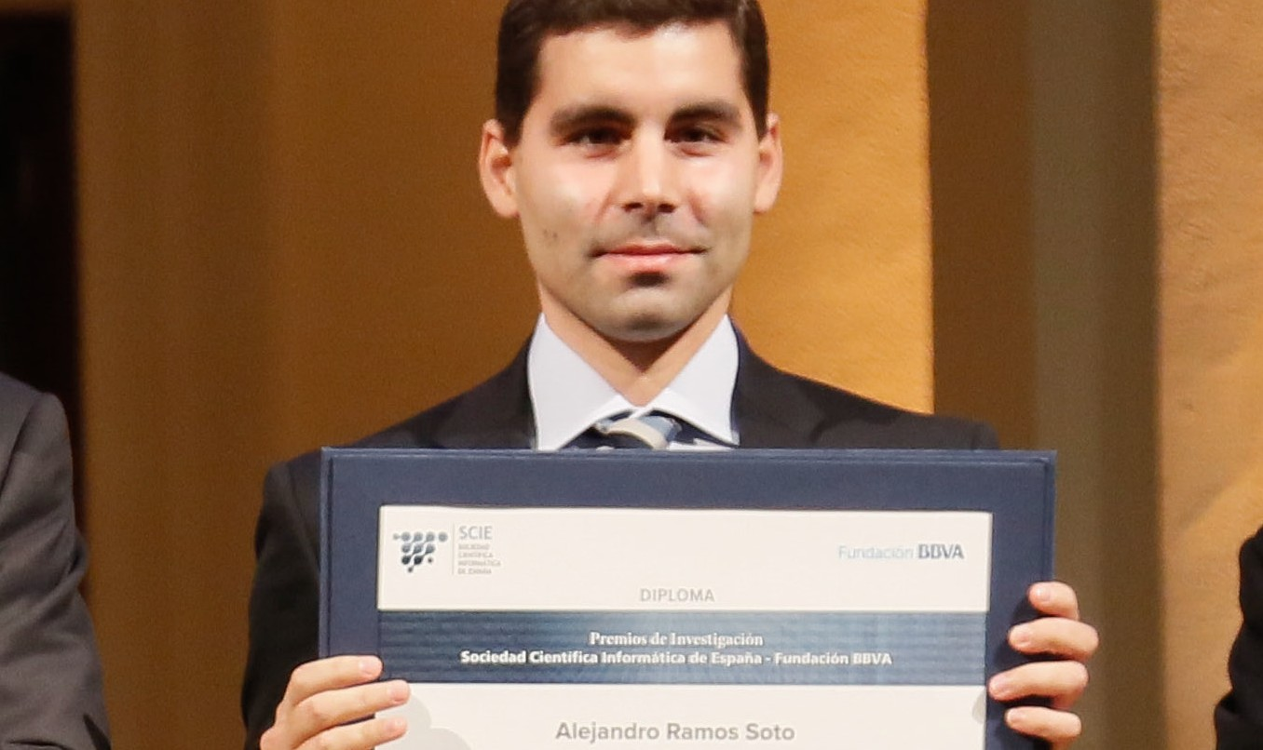
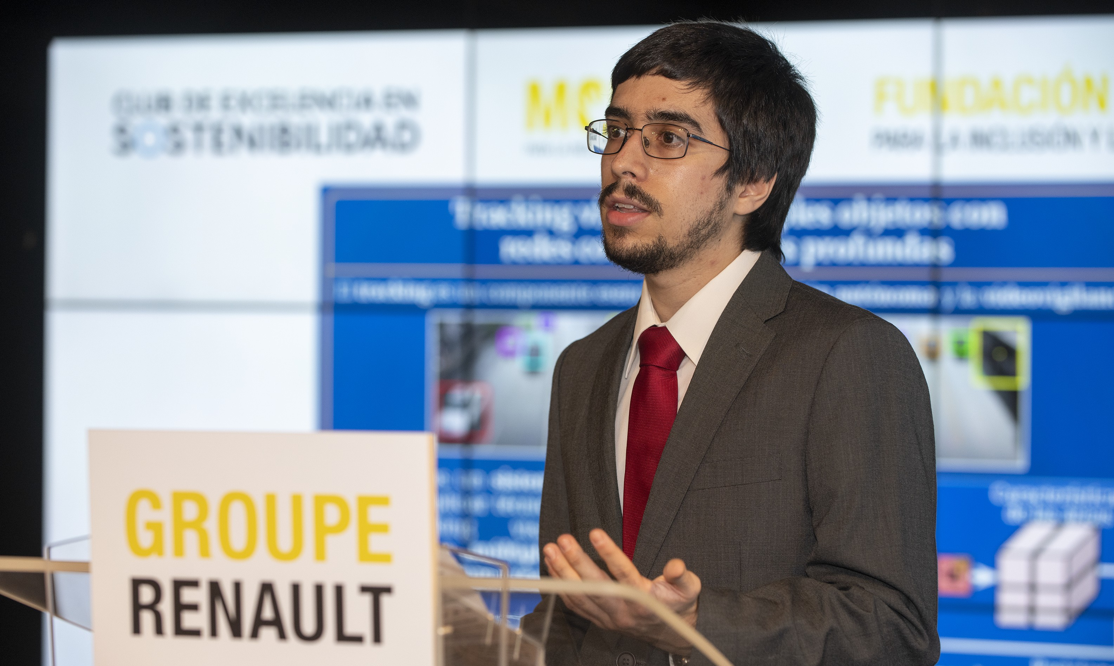
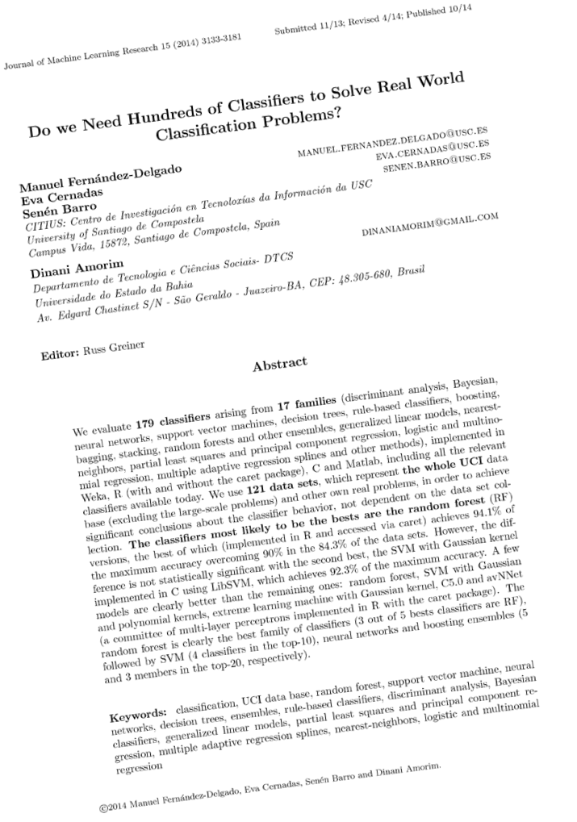
SOME ACHIEVEMENTS 2017-20
SOME SCIENTIFIC RECOGNITIONS
1ºPRIZE AT PHYSIONET
- COMPUTING
IN CARDIOLOGY CHALLENGE
T. Teijeiro, C. A. García, D. Castro y P. Félix
RESEARCH AWARD BBVA-SCIE,
NATIONAL PRIZE IN COMPUTER SCIENCE
S. Barro
RESEARCH AWARD BBVA-SCIE, BEST PhD AWARD, EUSFLAT
A. Ramos
>1.300
2017-19
TOP PAPER
Do we Need Hundreds of Classifiers to Solve Real World Classification Problems?
M. Fernández-Delgado, E. Cernadas, S. Barro y D. Amorim
RENAULT FOUNDATION AWARD
Highest National Prize in Mobility and Accessibility
L. Vaquero

Slide 10
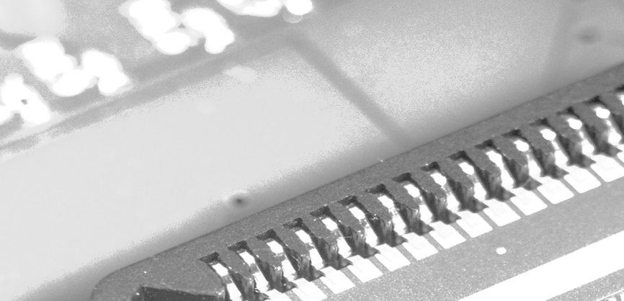
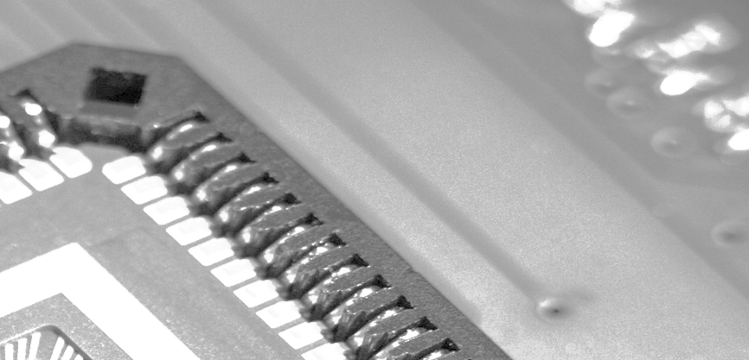
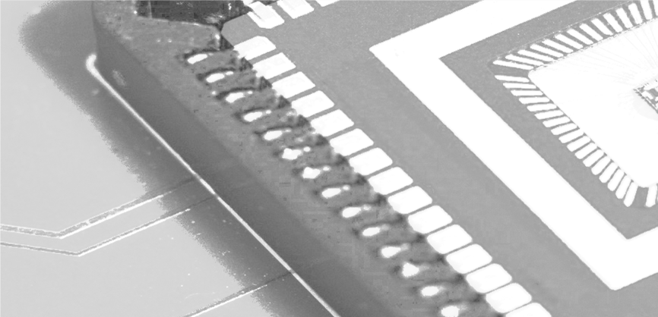
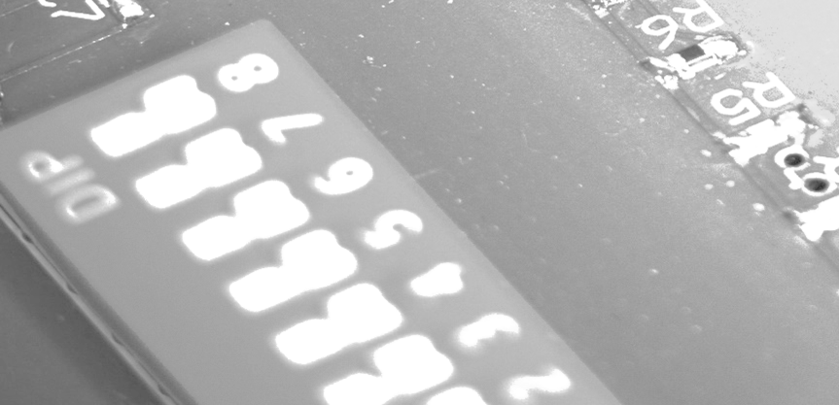
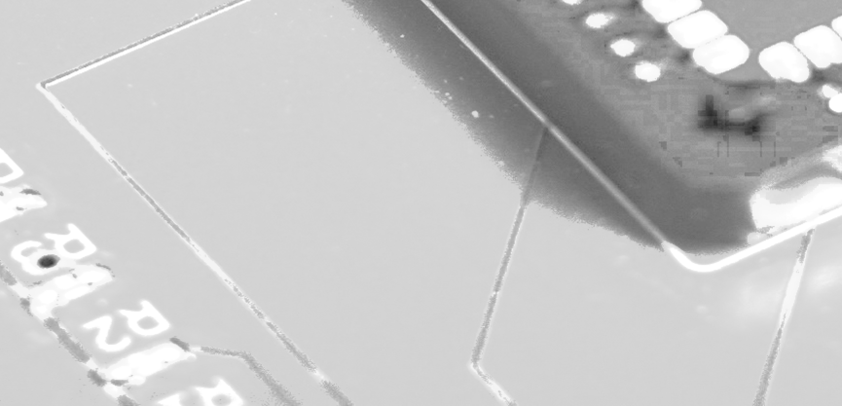
TECHNOLOGY TRANSFER (2017-2020)
38
R&D contracts
1
Semiconductor topography
2,3M€
Income
16
Software patents
30%
of USC royalties in 2017
1
Patent
6
Technology licenses

Slide 11
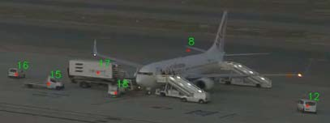
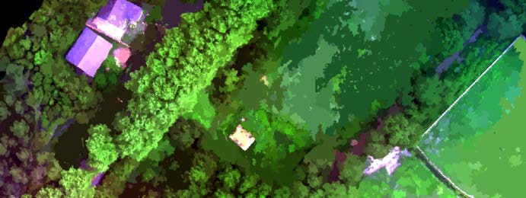
TECHNOLOGY TRANSFER
Machine learning for digital twins in the industry sector
Detection and tracking of objects for air traffic control
Methodology for benchmarks construction in information retrieval
Efficient processing of aerial images within the Civil UAVs Initiative

Slide 12
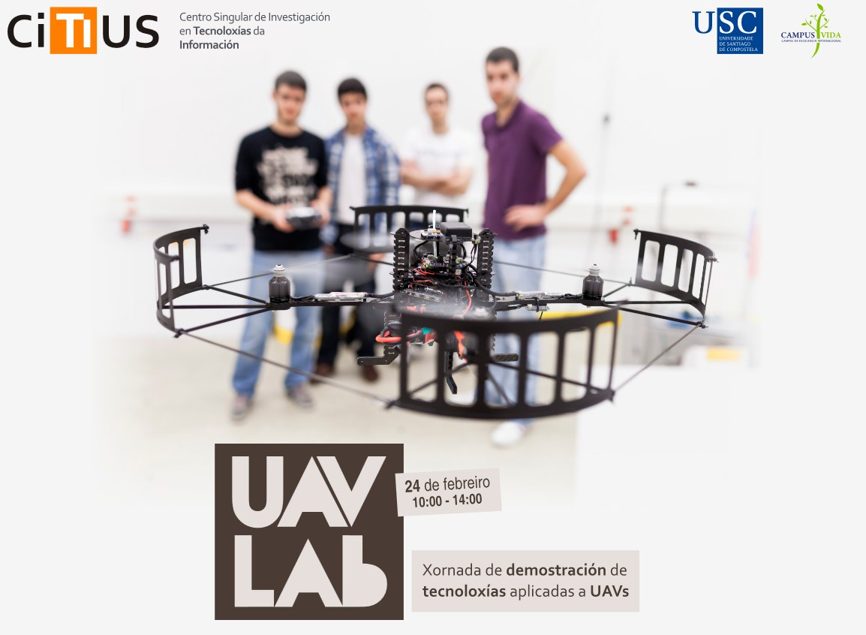
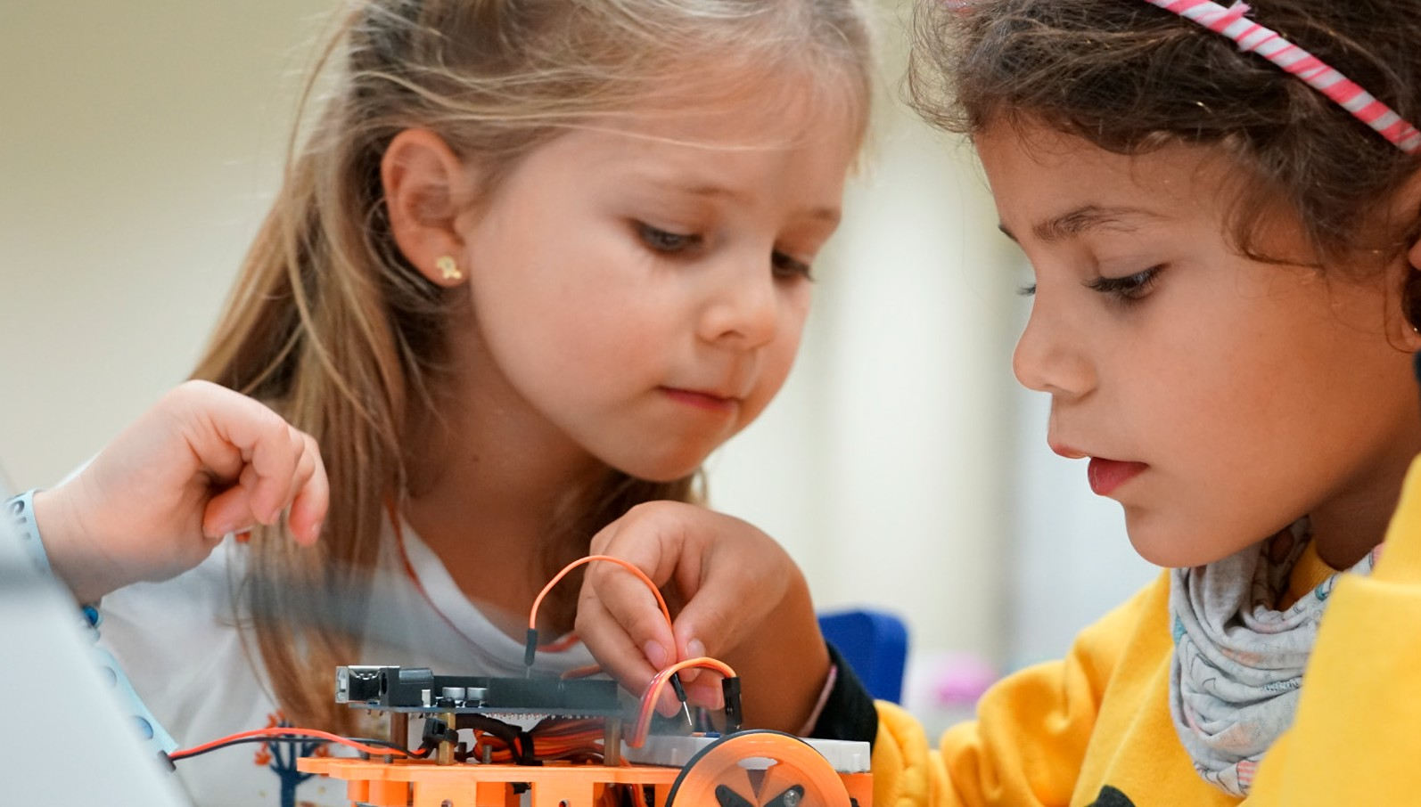
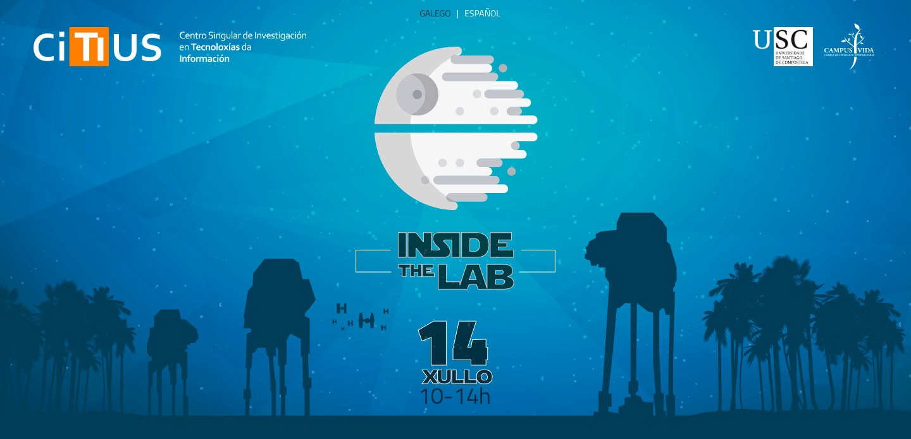
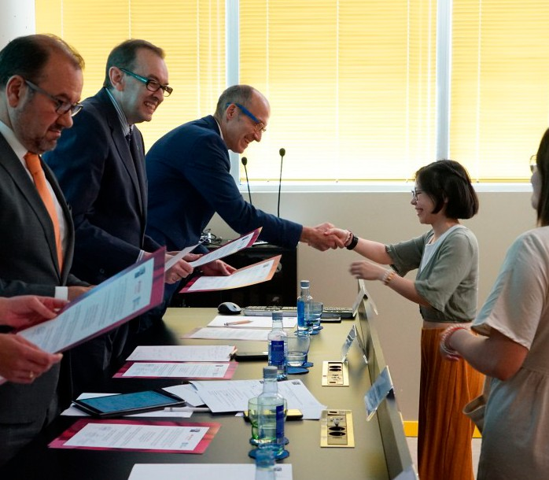
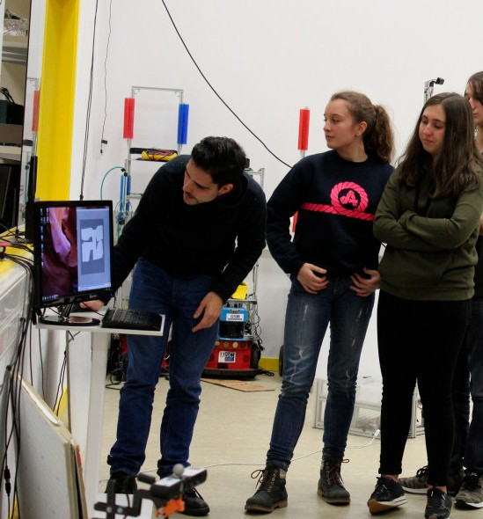
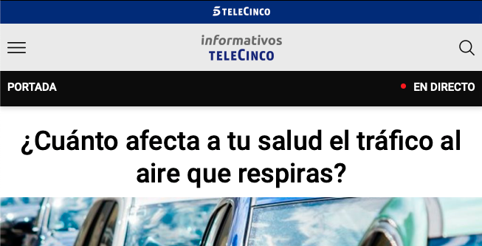
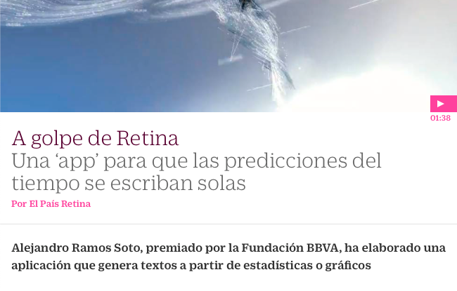
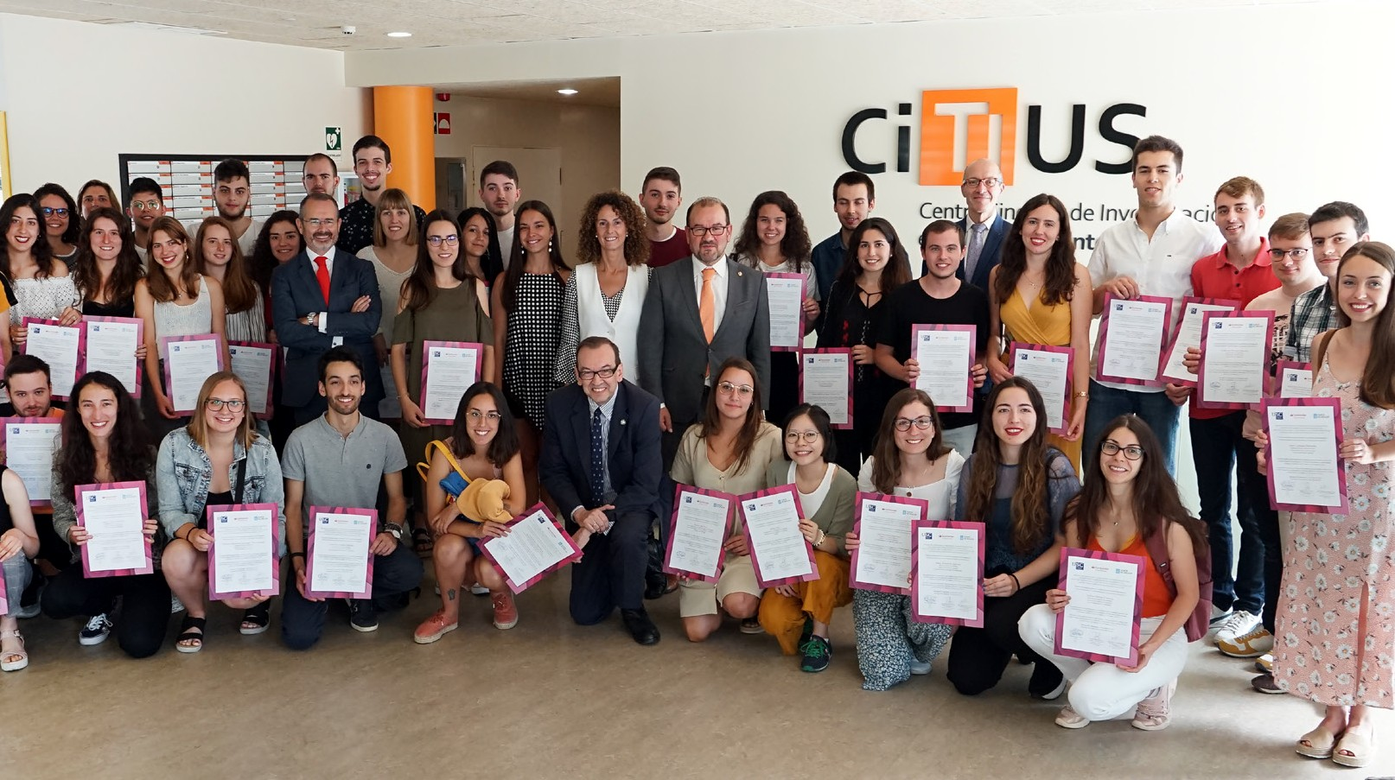
100
OUTREACH
100 VISITS
ORGANIZED PER YEAR
950
schoolchildren
PER YEAR
50.000
WEB VISITS PER YEAR
FOLLOWERS IN SOCIAL NETWORKS
+125% +130% +200%
>300
MEDIA IMPACTS

Slide 13
SPIN-OFFS
2014
Indoor positioning
25 people
China, EEUU, Japan, India, Peru, Saudi Arabia, +40 countries
Clients: AIS Thailand, Singapour banks, Prosegur, PSA Europa, …
2015
Serious games
13 people
UK, Mexico, Chile
Clients: New Balance, Alcampo, Husqvarna, Telepizza, FINSA, Abanca, Gullón, …
2020
Business processing analytics and natural language generation
Ignicia programme, 2018 call

Slide 14
INTELLIGENT TECHNOLOGIES AT EVERY STEP
From data acquisition to human-centered problem-solving and decision making
A
L
H
E
T
H
T
E
N
INTELLIGENT SENSING AND PERCEPTION
I
M
N
D
N
U
O
S
R
T
I
R
V
Y
N
E
INFORMATION ACCESS
DATA AND PROCESS ANALYSIS
S
Y
S
.
T
C
I
HIGH PERFORMANCE ARTIFICIAL INTELLIGENCE
C
R
TRUSTWORTHY ARTIFICIAL INTELLIGENCE
.
U
&
C
H
E
U
S
M
L
A
I
N
V
I
I
T
C
I
MACHINE LEARNING
E
S

Slide 15
citius.usc.es
FEDER
Fondo Europeo de Desenvolvemento Rexional "Unha maneira de facer Europa"

